Slide 1
National HIV Behavioral Surveillance (NHBS) Judith Bradford, Ph.D. Community Health Research Initiative jbbradfo@vcu.edu

Slide 2
NHBS
Purpose: Generate national statistics to better understand how transmission risks are distributed in the population.
In Virginia: Collaboration of Virginia Department of Health and VCU’s Community Health Research Initiative
Field site and staff based in Norfolk EMA.

Slide 3
NHBS Overview
25 sites across the country
3 populations, each studied in 3-year cycle
Methods and protocol development
Data collection
Analysis and reporting
Men who have sex with men
Injecting drug users
Heterosexuals living in High-Risk Areas (HRAs)

Slide 4
Study Design: NHBS-HET
Phase 1 – Formative Research
GIS to identify and describe HRAs (Chris)
Ethnographic activities
Street intercept surveys
Focus groups
Key informant interviews
Observations
Outcomes
Identify appropriate locations for quantitative phase
Create community awareness and engagement
Select initial seeds to start chain referrals

Slide 5
Study Design – NHBS HET
Phase 2 – Surveillance
Assess prevalence of and trends in HIV risk behaviors (sexual and drug-use behaviors)
Assess HIV testing behaviors
Prevalence and trends
Prevention
Exposure to and utilization of prevention services
Impact of prevention services on behavior
Identify prevention-service gaps

Slide 6
NHBS HET Partner Study
African American and Latina women refer their male sex partners
Interviews with male partners capture data about their risk behaviors
Explore extent to which minority women’s perceptions of partners’ risk behaviors match what male partners report

Slide 7
Virginia NHBS
Norfolk Virginia MSA
Eastern Virginia health region #1 in number of HIV infections and AIDS cases.
Among HIV/AIDS cases, 30% are women living with HIV, 26% of AIDS cases are women (4.9 AA females to every 1 Caucasian female)
African Americans are 72% of HIV cases, 69% of AIDS cases.

Slide 8
Heterosexual Sex as HIV Risk Factor
34% of all adult and adolescent HIV/AIDS cases reported by 33 areas with name reporting in 2003.
Among female adults and adolescents, 79% of HIV/AIDS cases by heterosexual sex.
Shift from homosexual to heterosexual contact as transmission risk.
In 2003, 80% of all reported cases were among African American and Latina women.

Slide 9
Methodological Challenges
Hard-to-study populations
Who participates in research – why and why not?
Human subjects concerns:
No harm to participant
Full disclosure
No coercion
Individual and community benefit
Giving information back

Slide 10
Sampling Issues
Classic probability sampling impossible to achieve
Hidden populations – how to access them
Illegal or socially-disapproved behavior
Distrust of the research enterprise
Structural barriers, such as accessibility of the research site
New approach: social network methods

Slide 11
…the nature of human relationships – the degree to which an individual is interconnected and embedded in a community – is vital to an individual’s health and well-being as well as to the health and vitality of entire populations.
Berkman LF, Glass T. Social integration, social networks, social support and health, in Social Epidemiology, Berkman LF and Kawachi I, Eds. New York: Oxford University Press, 2000.

Slide 12
How social networks impact health
Social-structural conditions (macro factors) condition the extent, shape and nature of…
Social networks (mezzo factors), which provides opportunities for…
Psychosocial mechanisms (micro factors), which impacts health through these pathways:
Health behavioral pathways
Psychological pathways
Physiologic pathways

Slide 13
Social-structural conditions (macro factors)
Culture - norms and values, social cohesion, racism, sexism, cooperation/competition
Socioeconomic factors – inequality, discrimination, conflict, poverty, labor market structure
Politics – laws, public policy, political culture, differential enfranchisement/participation
Social change – urbanization, war/civil unrest, economic “depression”

Slide 14
Social Networks (Mezzo Factors)
Social network structure
Size, range, density, boundedness, proximity, homogeneity, reachability
Characteristics of network ties
Frequency of face-to-face contact, of nonvisual contact, of organizational participation (attendance),
Reciprocity of ties, duration, intimacy

Slide 15
Psychosocial Mechanisms (Micro Factors)
Social support – instrumental and financial, informational, appraisal, emotional
Social influence – constraining/enabling influences on health behaviors, peer pressure
Social engagement – reinforcement of meaningful social roles, bonding/interpersonal attachment
Person-to-person contact – close personal contact, intimate contact
Access to resources and material goods – access to health care, housing, human capital, jobs, institutional contacts

Slide 16
Pathways
Health behavioral pathways – smoking, alcohol consumption, diet, exercise, adherence to medical treatments, help-seeking behavior
Psychological pathways – self-efficacy, self-esteem, coping effectiveness, depression/distress, sense of well-being
Physiologic pathways – allostatic load, immune system function, cardiovascular reactivity, cardiopulmonary fitness, transmission of infectious disease

Slide 17
Social-Structural Conditions (Macro Factors)
↓
Social Networks (Mezzo Factors)
↓
Psychosocial Mechanisms (Micro Factors)
↓
Pathways Health behavioral, psychological, physiologic

Slide 18
Chain-referral Sampling
Snowball sampling - proven but non-probability method
Respondent-driven sampling – snowball with stats = probability method

Slide 19
RDS Implementation: “6 degrees of separation”
Researchers recruit handful of “seeds” – sociometric stars
Seeds offered financial incentives to recruit peers – recruitment coupons turned in at interview site spark payment.
All new recruits offered same dual incentives.
Each gets 3 initial coupons
Extra set can be given under conditions
Trait membership must be objectively verifiable, e.g. track marks for IDUs.

Slide 20
RDS Implementation
Subject identification when present for interview (with coupon). E.g, database of physical characteristics for IDUs.
“Steering” incentives – extra bonus for subgroup recruitment.
End sampling at equilibrium, perhaps at minimum sampling size and composition.

Slide 21
RDS Conditions
Activities that constitute network membership must create connections.
Must be able to verify the trait objectively, using a well-tested screening protocol.
Done correctly, RDS sample is wholly independent of initial set of recruits.
Successive waves will eventually produce equilibrium.
"Finding the beat: Using respondent-driven sampling to study jazz musicians," by Douglas D. Heckathorn and Joan Jeffri [Poetics 28 (2001) 307-329].

Slide 22
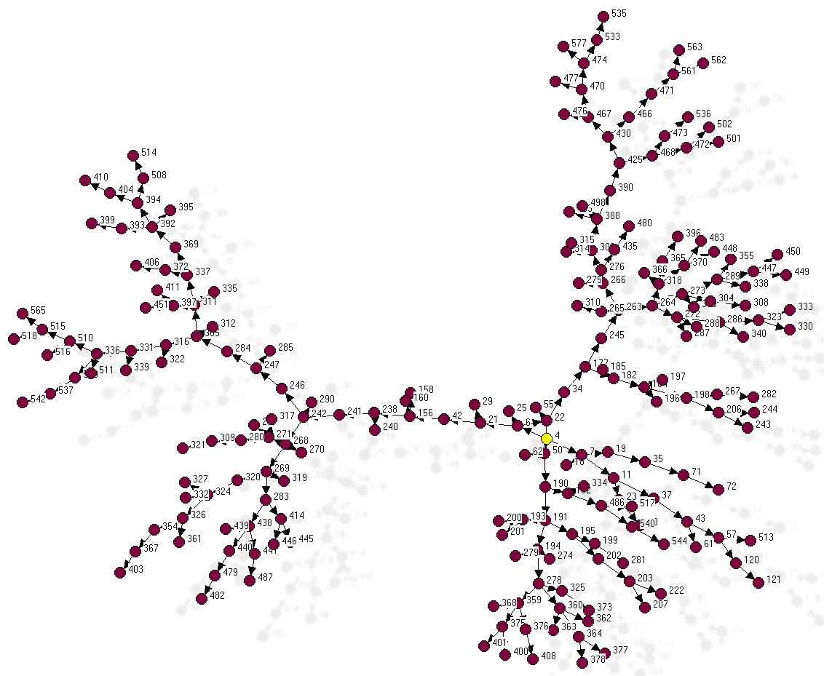
IDU Chains

